Slide 1
Project d

Slide 2
Motivation
“Around 330,000 drowsy driving crashes occur annually. About 6,400 people were killed in such incidents.”

Slide 3
justification
-Some vehicles are equipped with safety features such as lane assist and automatic emergency braking system.
-However, sometimes it is too late for such features to kick in to prevent accidents.

Slide 4
concept & GOAL
-Embedded IoT device to identify drivers drowsiness according to drivers’ eye and mouth position.
-When a driver is identified to be drowsy, alarms will be triggered to warn the driver.
-The goal of this concept is to contribute to overall road safety improvement.

Slide 5
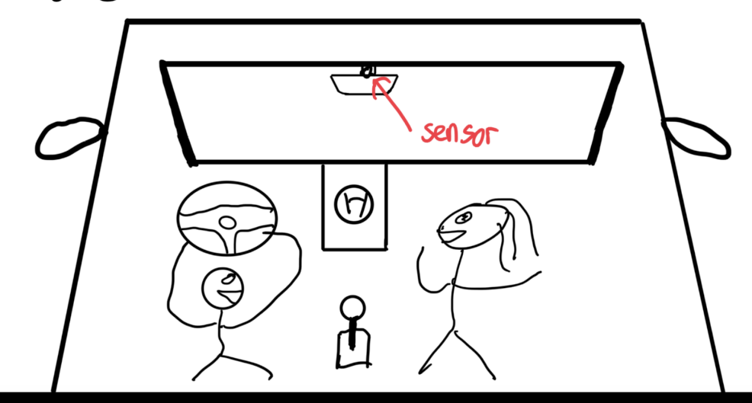
Graphic Demo

Slide 6
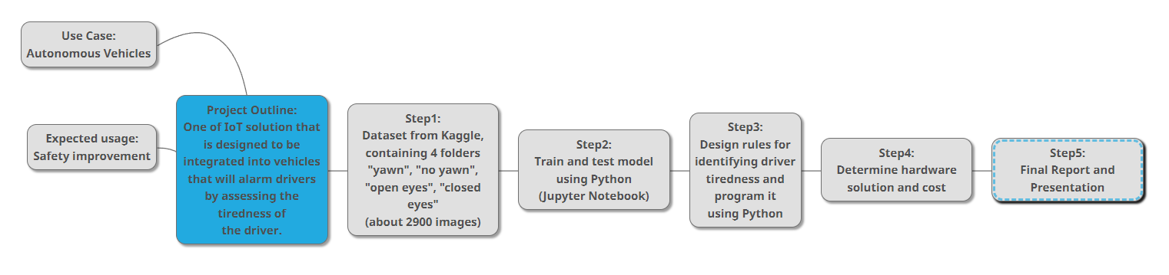
SOLUTION ARCHITECTURE

Slide 7
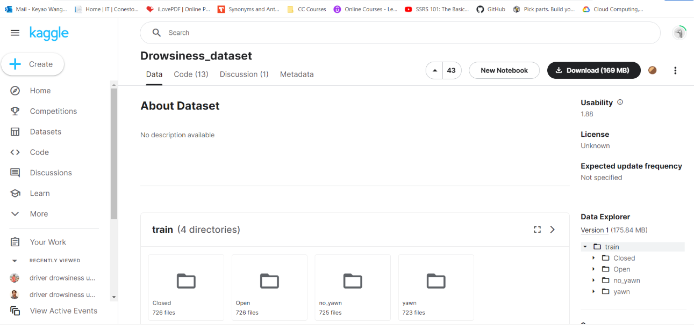
Data access

Slide 8
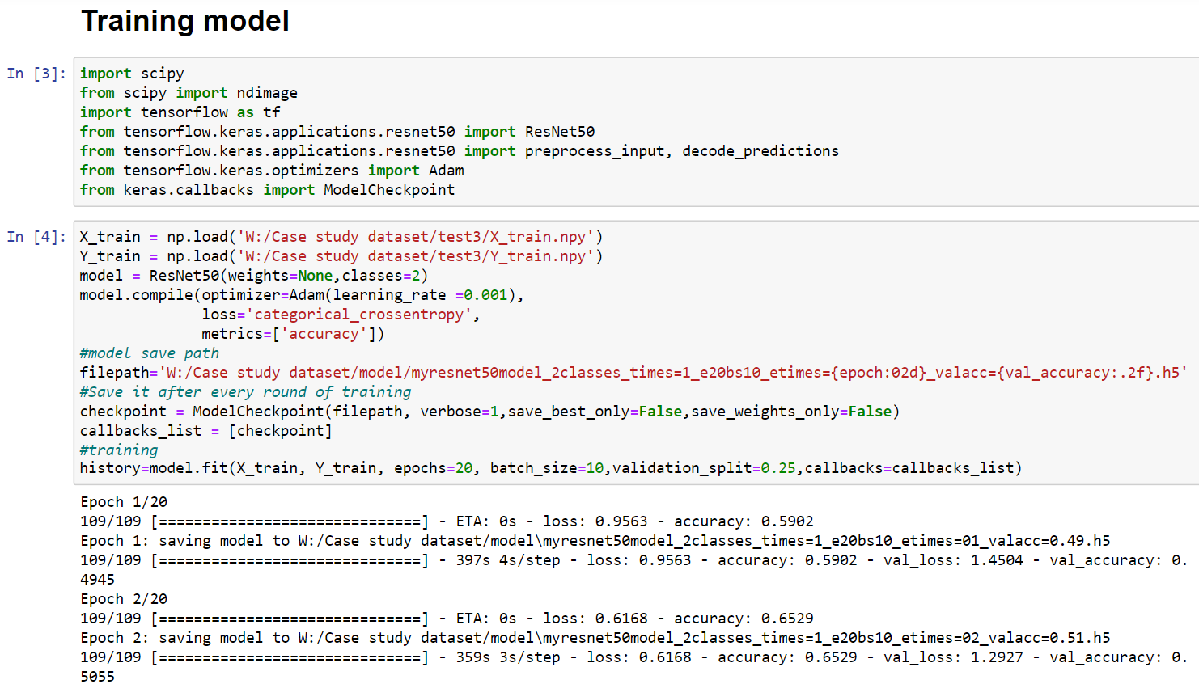
Train/Test Datasets “yawn” & “no yawn”

Slide 9
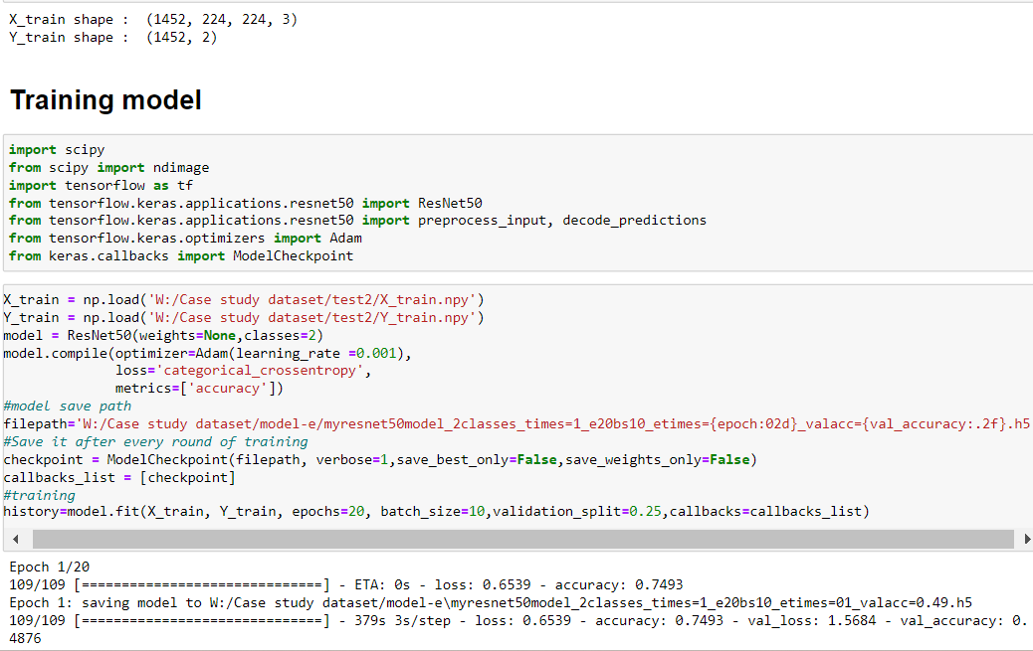
Train/Test Datasets “OPEN EYE” & “CLOSED EYE”
Same procedure

Slide 10
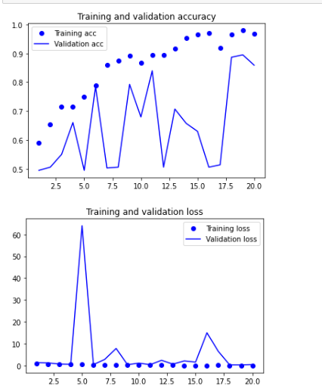
Model accuracy
-In order to avoid overfitting, we used random test samples instead of a fixed one.
-The final model accuracy
is around 95%

Slide 11
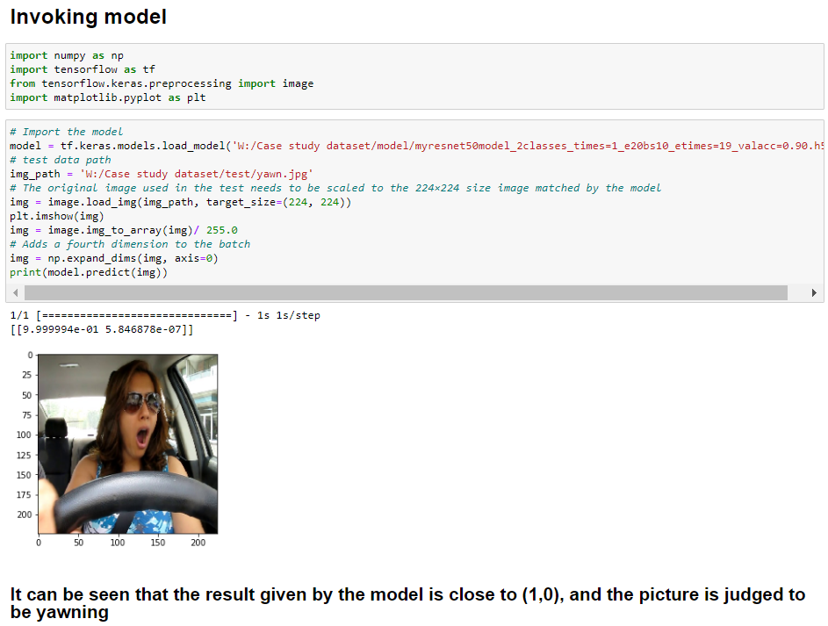
Connect model to real application

Slide 12
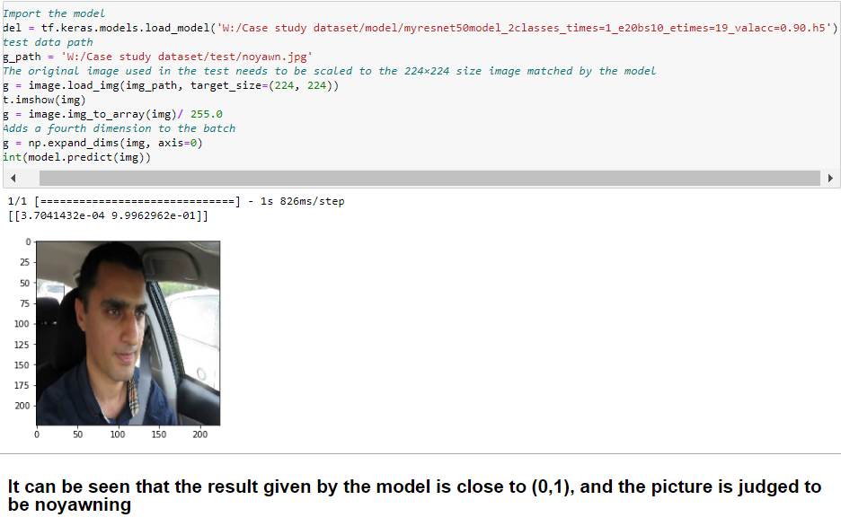
Connect model to real application

Slide 13
DEFINE RULES FOR WARNING
If driver yawns, first warning will be triggered.
=> If the drivers eye is also closed, a warning will be triggered every 0.5 seconds until the driver opens eyes. => The sensor will operate synchronously with the system which takes a picture of the driver every 0.5sec and load into the dataset for the system to check.

Slide 14
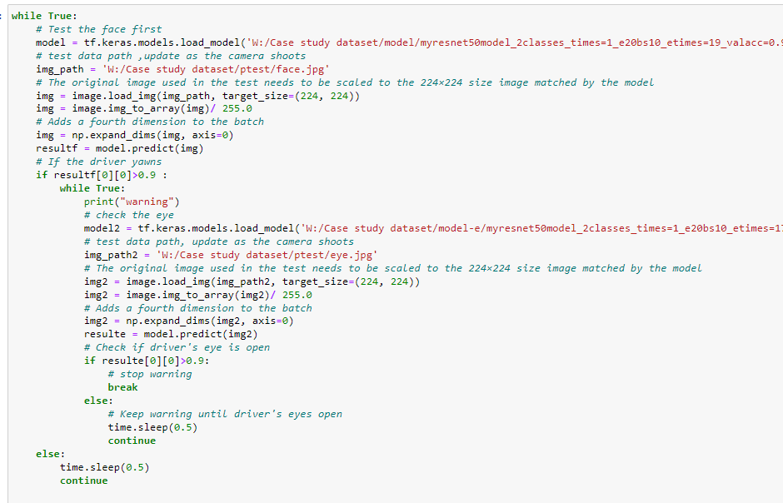
WARNING SYSTEM

Slide 15
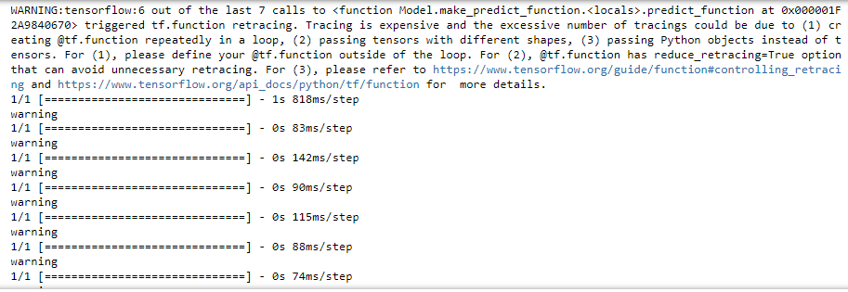
SYSTEM CHECK
Result: It prints warning messages accurately.

Slide 16
Opportunity
-Improve the overall road safety across the globe.
-Reduce accident rates caused by impaired driving and potentially save lives.
-Ease the investigating procedures when deadly accidents happen, since the actions of the drivers are recorded, similar concept to the “black box” on airplanes.

Slide 17
CHALLENGES
-When it comes to IoT applications, PRIVACY is always a concern by the general public.
-Most people do not feel comfortable when being “monitored” by a camera.

Slide 18
Potential solution
1. All pictures being captured are stored locally only. 2. Optional switch: the driver has the option to turn the device off. 3. Erase all data when each driving session is over. (Start fresh each time)

Slide 19
SUMMARY
-Language: Python
-Techniques used: Machine Learning Classification
-Algorithm used: CNN (Convolutional neural network)
-Model: pre-trained model “ResNet50” from the TensorFlow library.

Slide 20
THANK YOU

